Slide 1
Group No.55
FA2-BSIT1-7

Slide 2
Presentation of Final Requirements

Slide 3
Instructions
Using Google slides, the group will create a presentation on the data the gathered on day 23 with their sample layout or output and Day 24&25 with the specification of computer system.
The group will defend their answers in front of the panelists.
Questions and answers will be done after the presentation.

Slide 4
Part 1. Problem-solving Presentation
Day 23
Problem Solving 1-Computational & Critical Thinking

Slide 5
Instructions
Group the students into 5 members.
Each group must have leader and the leader will assign the task for each member.
Type the list of the members and their assigned tasks below.
Member 1 & Leader: Valerie M. Martinez -logo designer and editor ,make the google slides, actor and script writer.
Member 2: Brix B. Almelia - Researcher and logo designer
Member 3: Josrey Patnubay - Researcher, Presenter

Slide 6
Member 4: Jayson Degayo - Researcher
Member 5: Cleofe Jane Catam-isa - Researcher
4. Choose only one (1) scenario.
5. Answer and provide tools on what is being asked in the problem
6. Provide a sample layout or output on the chosen scenario by using the available computing tools.

Slide 7
Scenario 1
Ana is planning to open her salon business and she needs to prepare and plan her brand logo. Her salon business is named, “Ana’s Beauty Salon”. As a graphic artist, you need to help her in creating her brand logo for her salon. Provide what are the needed requirements to create her brand logo.

Slide 8
Requirements
The idea or design of the logo (of course we can’t make the logo if we don’t have the idea what design to make)
Laptop (where we can use the app)
Photoshop app (is the app we use for editing the logo)
Internet Connection (There are times that the design we got turned out not suited for the background we choose so we search for replacement)

Slide 9


Slide 10
Questions:
What are the software and devices to be used in creating a brand logo?
We use photoshop in creating our brand logo.
Is it online platform or not? If yes, what online platform? If not, what platform are you going to use?
You must connect to the Internet when you want to install Adobe Creative Cloud apps, such as Photoshop . Once the app is installed on your computer, you don't need an ongoing Internet connection to use the app.

Slide 11
3. What important features must be present in creating the brand logo?
The important features in creating a brand logo are simple,memorable, and timeless.
4. What could be the potential problems that might be incurred and how can you be initially addressed the problems?
The potential problems that might be incurred was during the making of logo we are using a laptop which does not have good specs to support the photoshop app that’s why we are having difficulties in creating the logo especially when its lagging and the app automatically not working or not responding. We tried to delete some apps in our laptop and tried to defragment our laptop to help organize the data in our hard drive and improve its performance especially in terms of speed. That really helps us to finish creating our logo.

Slide 12
Problem Solving 2
Day 24 & 25 Design Thinking

Slide 13
Instructions
With the same group as the previous activity, the teacher will have to assign what scenario the group will answer.

Slide 14
Scenario B
You worked as a sales personnel in a computer shop. One customer wants to buy a laptop for her office work. She works as an executive secretary in a company and uses productivity tools such as Microsoft Word, Microsoft Excel, and Microsoft PowerPoint. She used web browsers for her daily task and videoconferencing meetings. The online application she also used is Google Workspace (Gmail, Calendar, Drive, Docs, Sheets, Slides, Meet, and more). To communicate with her boss and other colleagues, she used Google Hangouts. The secretary stores a lot of files on her old laptop ad needs to transfer them to the new laptop. She wanted to have a lightweight laptop so that she can bring it when she travels. Her budget is 19,000 pesos. Your job is to market and convince the buyer to choose and buy the Lenovo X1 Carbon 14” Touchscreen Display laptop.

Slide 15
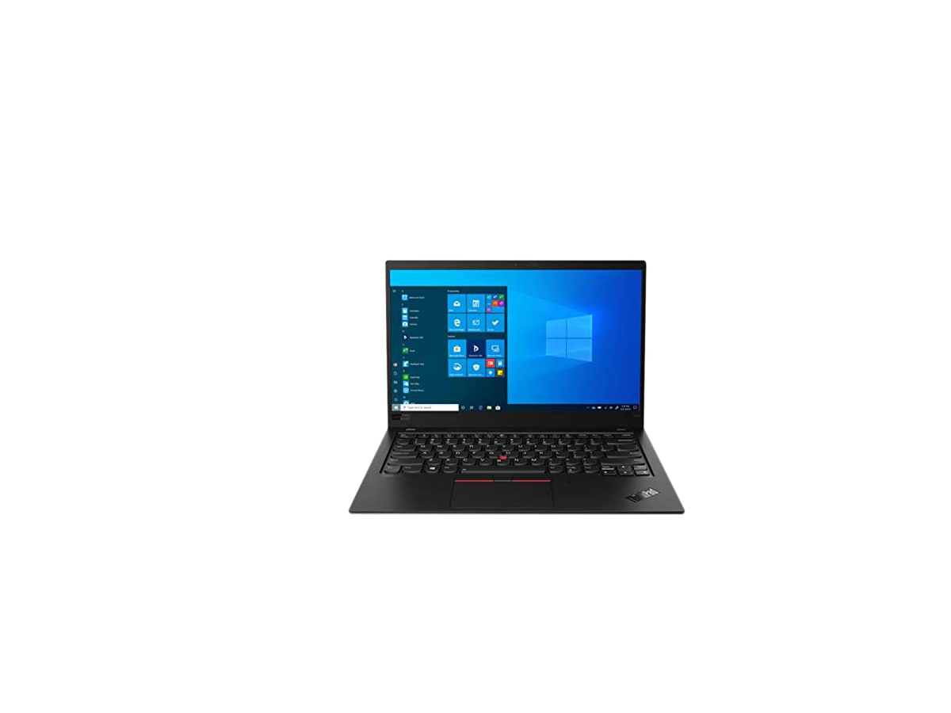
Specification
Renewed - Lenovo X1 Carbon Black/ X1-8g256
14” Touchscreen Display Laptop Price: 21,449 pesos
5th Gen Intel Core i7 Processor Cash: Less than 1,000 pesos
8GB RAM Installment: 25,738 (24 months to pay)
256GB SSD/ROM
Windows 10 Home,
English Keyboard

Slide 16
The Lenovo X1 carbon is just the best laptop for her especially for her work.
This laptop has a 5th gen Intel core i7 Processor, 8 GB of RAM and 256 SSD or ROM that really can help her with her work. She can run several tabs in chrome, watching an offline video,writing a document or using formulas in a spreadsheet without worrying about lagging. She can also store a lot of files because of its big storage capacity. This also already has windows 10, 14 inch Touchscreen display and has a resolution of 1920 x 1080. As she wants a lightweight laptop this laptop is perfect for what she wants because this laptop is 2.49 lbs or 1.13 kg only. And is pretty thin as well, slimming down from 0.65 to 0.6 inches in thickness. The price of this laptop is quite high from her budget but she can still have it in second option which is installment and can pay for 24 months.

Slide 17
Thank you so much!!🥰

